Slide 1

Project – C Ethical Hacking
Rodrick Stephen

Slide 2
Executive Summary
This report provides a compendium detailed network upgrade that includes installing and configuring a new Production server to Project–C- internal network to support production and operations. Moreover, malware analysis was conducted, such as advanced static and dynamic analysis to find vulnerabilities of the new Production server and the existing Web-server to mitigate exploits by threat actors.

Slide 3
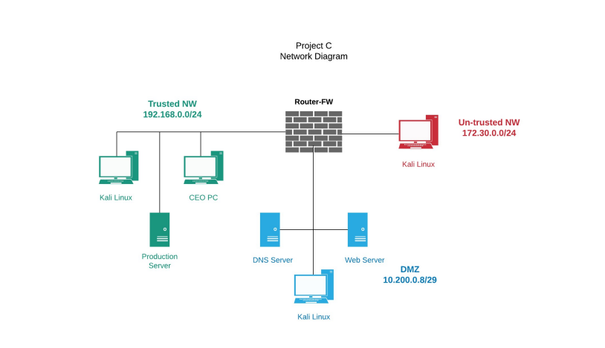

Slide 4
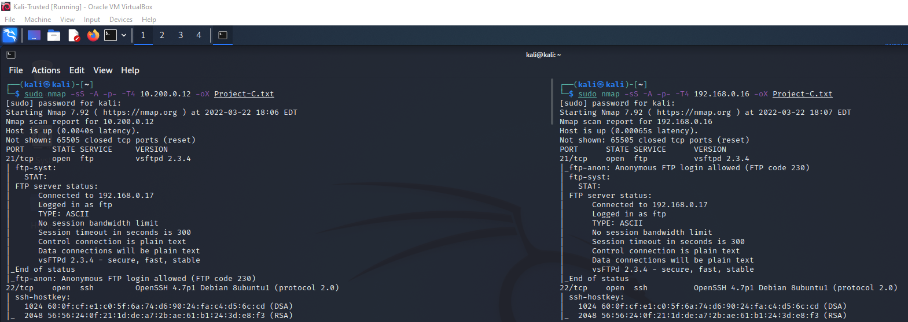
NMAP vulnerability scan and Enumeration 192.168.0.16 – 10200.0.16: vsftpd 2.3.4

Slide 5
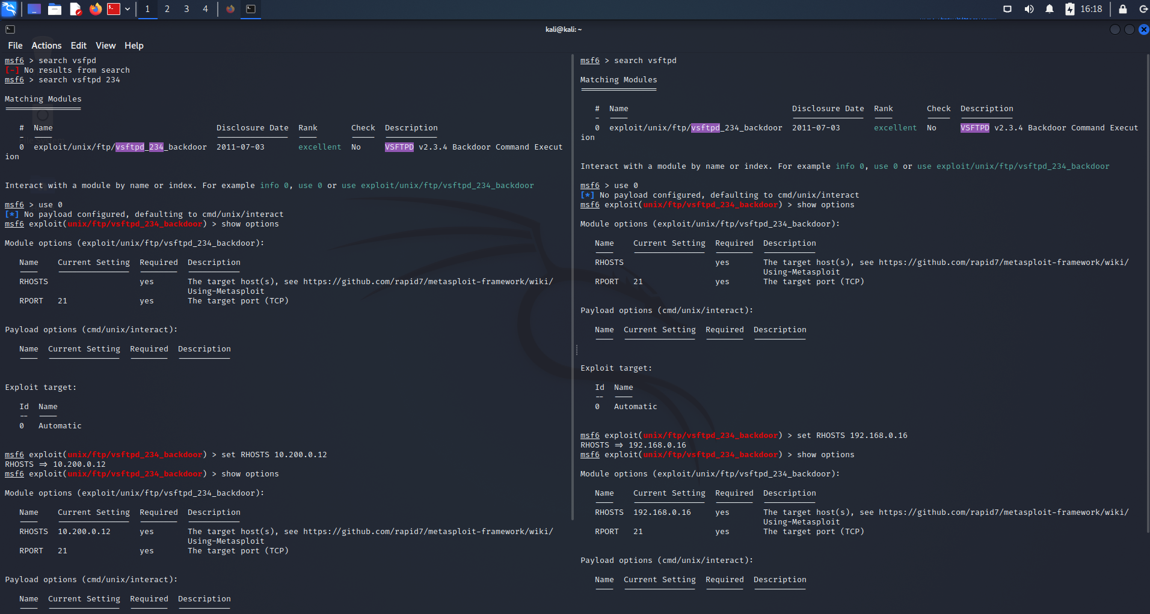
CVE-2011-2523
More reconnaissance and footprinting using Nmap command: nmap 10.200.0.12 –script=vuln / nmap 192.168.0.16 –script=vuln
vsftpd 2.3.4 downloaded between 20110630 and 20110703 contains a backdoor which opens a shell on port 6200/tcp.

Slide 6
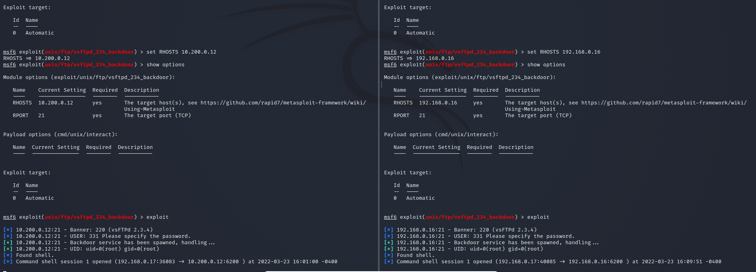

Slide 7
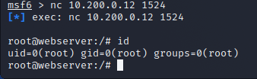
Ingreslock Backdoor port 1524/tcp open on IP address 10.200.0.12 may be used as a backdoor
by various programs, which may exploit RPC (remote procedure call) services. According to security experts,
the Ingreslock backdoor may be used as an intentional backdoor by malicious actors to obtain
access to a system. Malicious actors only need to connect to the port, and they will be logged in,
having the same privileges as the user running the service.
CVE-2013-4730
Users who have suspicions that a backdoor has sneaked into their systems should lock down
the TCP 1524 port at the firewall. The best way to fix this problem is to call your Internet provider,
explain the issue and ask them to lock down the troublesome port for you

Slide 8
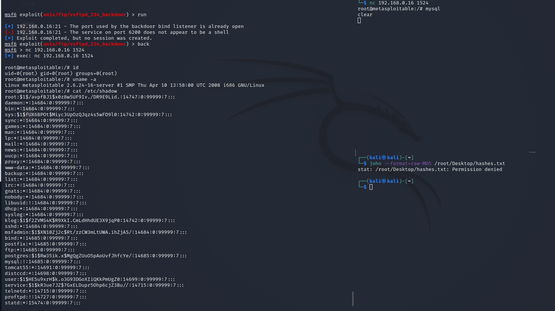
nc 192.168.0.16 1524 exploit root access

Slide 9
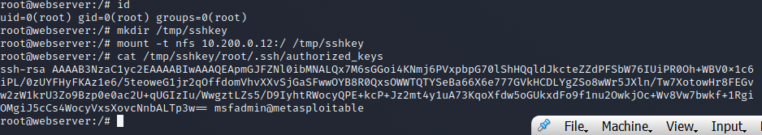
The nfs services allows network access to local file systems. On IP Address 10.200.0.12
The nfs service on the system allows anyone to remotely mount the local file system and
access or modify its contents. We can use this to grab authorized SSH keys from the system
or to write our own SSH keys to the authorized keys file. Linux is the affected server.
CVE-2022-2536
To fix this, split gc into two-phase that are available at the site below.
https://lkml.kernel.org/lkml/20190121134914.234510860@linuxfoundation.org/

Slide 10
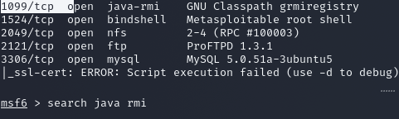
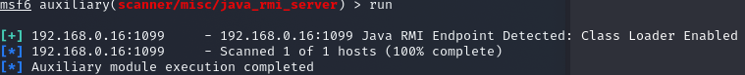
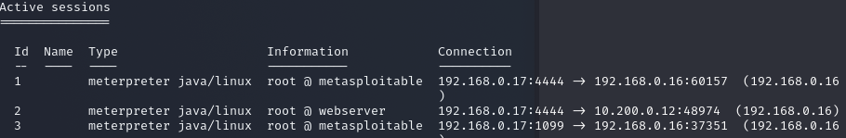
Java-RMI Exploit
CVE_2021-37578
RMI uses the default Java serialization mechanism to pass parameters in RMI invocations.
A remote attacker can send a malicious serialized object to the above RMI entries.
The objects get deserialized without any check on the incoming data. In the worst case,
it may let the attacker run arbitrary code remotely

Slide 11
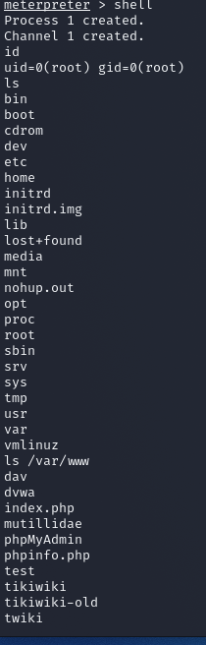
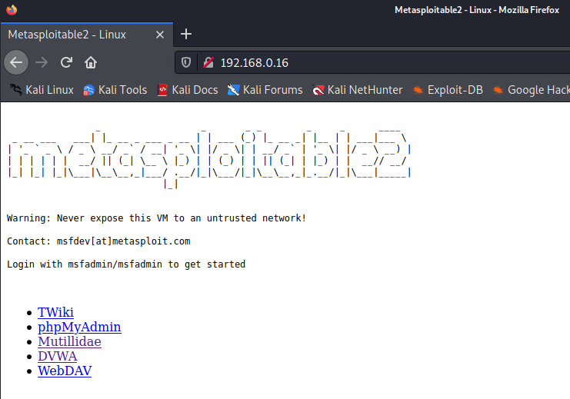
Java RMI meterpeter > shell EXAMPLE

Slide 12
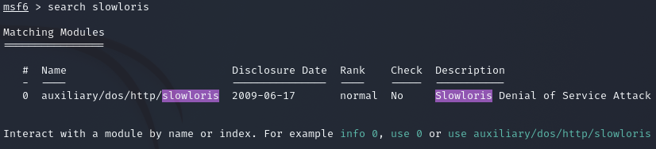
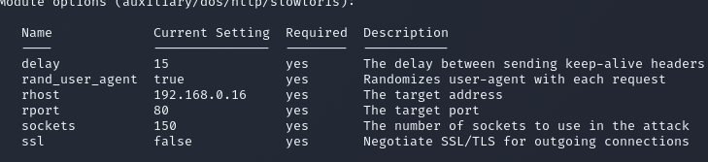
Slowloris exploit
An attack in which the attacker send pieces of HTTP request
one at a time with the hopes of overwhelming a web server
CVE-2017-7670

Slide 13
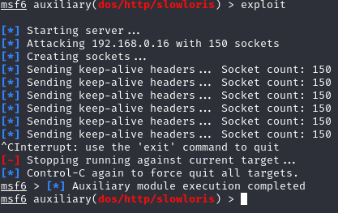
The attacker stops the attack by pressing the Ctrl + C keys

Slide 14
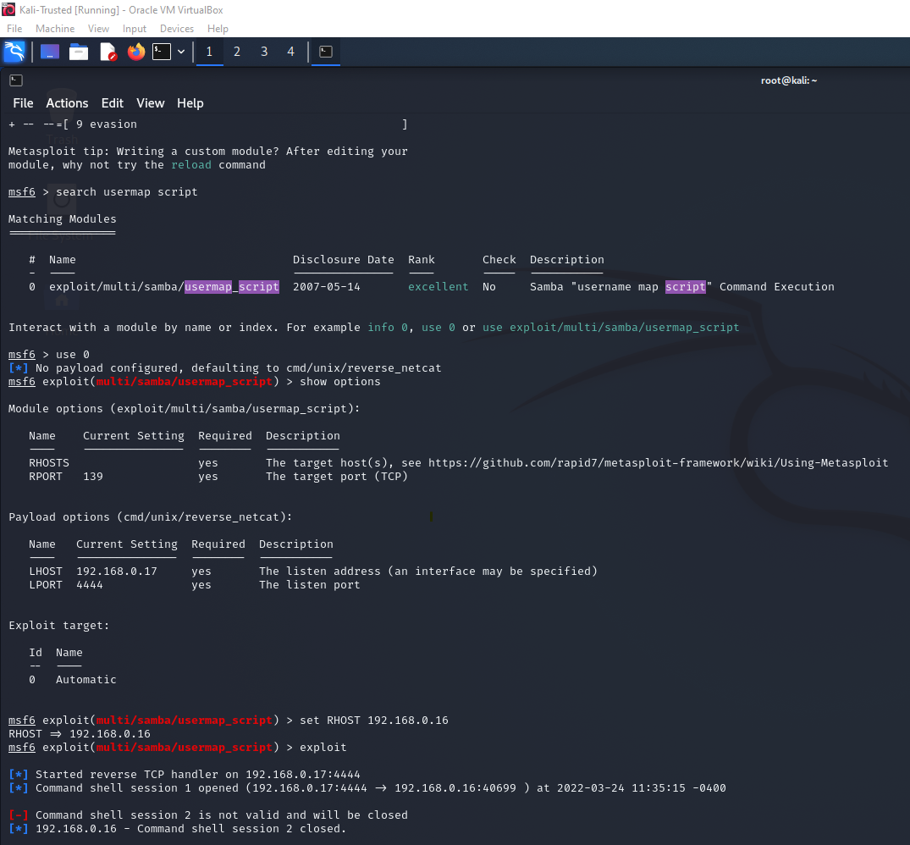
Usermap_script Exploit cve-2007-2447

Slide 15
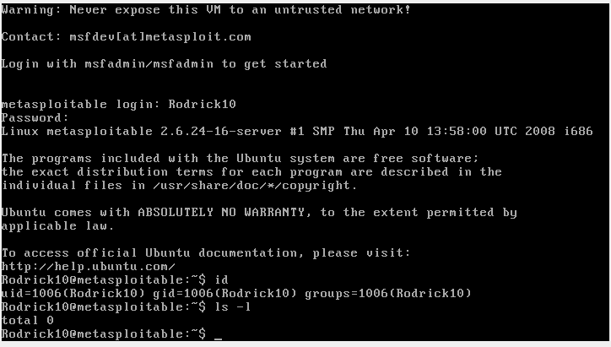
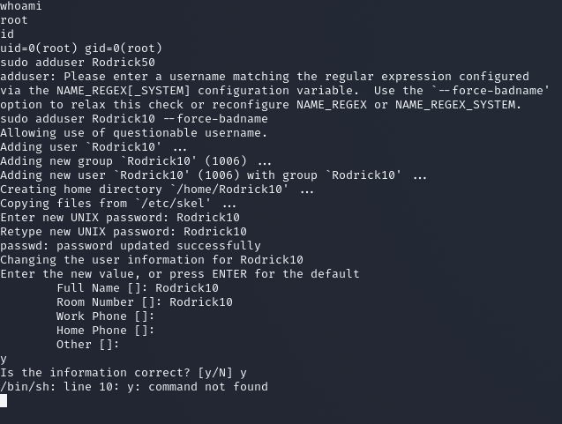
Added Rodrick10 on the Production Server as a user

Slide 16
